Slide 1
Funding Strategy for Immigration Advice in London
30th June 2021

Slide 2
The context
Hostile environment
Brexit
EU Settlement Scheme
‘New Plan for Immigration’
Windrush scandal
Cuts to Legal Aid

Slide 3
The gulf between demand and supply
The most recent estimate of demand in London is in the hundreds of thousands.
The estimated total supply of immigration advice case work is 4,000-4,500 cases per year.
'A Huge Gulf: Demand for and Supply of Immigration Legal Advice in London’
By Jo Wilding, Maureen Mguni and Travis van Isacker
Published by The Paul Hamlyn Foundation, June 2021

Slide 4
WHY should funders care?
If you fund work to tackle poverty
If you fund employment initiatives
if you fund community health projects
If you fund homelessness organisations
If you fund work with children
If you fund race equality
If you are funding covid recovery work
If you are a funder in London, poor access to immigration advice is likely to be increasing demand in your field, and you can’t afford to ignore it.

Slide 5
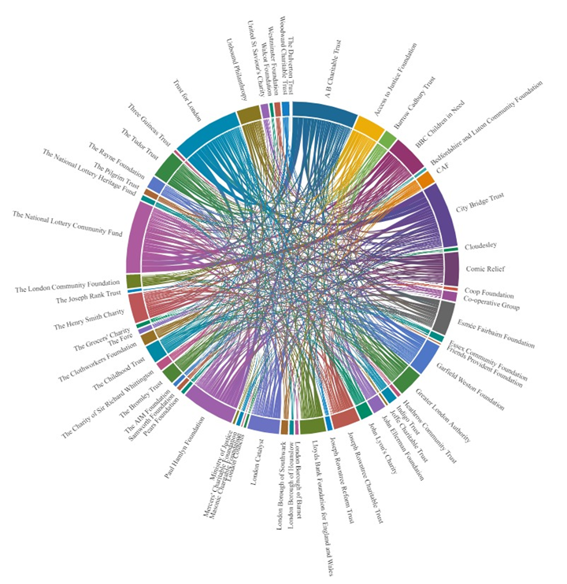
Funders making grants to organisations that provide immigration advice
https://public.flourish.studio/visualisation/4911966/

Slide 6
Our shared vision
A robust and sustainable immigration advice sector that meets the needs of Londoners who do not have the rights and entitlements afforded to British citizens.
This sector is supported by long-term, strategic and intelligent funding, which takes account of the whole system of frontline provision, effective infrastructure, and advocacy for fairer policy-making.

Slide 7
This sector will be able to:
ensure that high-quality and effective advice, casework and legal support is accessible to Londoners who need to secure their status and move forward in their lives;
recruit and retain skilled staff in the sector, by managing a pipeline of training and skills;
organise itself to support partnerships with grassroots organisations and statutory services, reaching those who need advice early (and urgently) and ensuring there is no ‘wrong door’ or ‘dead end’;
contribute its experience and expertise to policy-making to build a fairer and more effective immigration system for all.

Slide 8
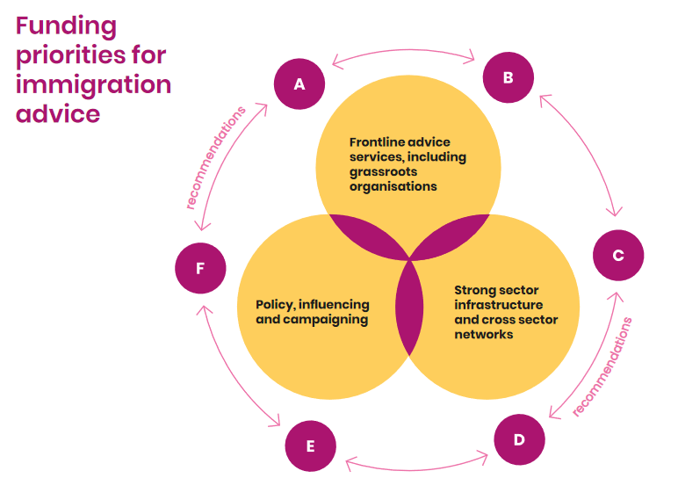

Slide 9
WHAT can funders do?
INCREASe ACCESS TO Frontline IMMIGRATION Advice
A: Support grassroots and frontline advice organisations, ensuring the people they support understand how to access their rights and are supported to do so.
B: Early action – embed immigration advice into community settings and others service such as employment, benefits, housing and health.

Slide 10
WHAT can funders do?
BUILD STRONG SECTOR INFRASTRUCTURE AND NETWORKS
C: Strengthen the pipeline, recruitment and retention of immigration advisors in the sector, taking the cost of workforce development for the sector out of individual organisations.
D: Invest in sector infrastructure to co-ordinate partnerships and networks, ensuring there are no wrong doors, and there is always a pathway to help at the level at which it is needed.

Slide 11
WHAT can funders do?
STRENGTHEN POLICY INFLUENCING AND CAMPAIGNING
E: Connect the frontline experience to policy and advocacy through the Justice Together Initiative.
F: Build advocates for access to justice by investing in the leadership of people with both lived and technical experience.

Slide 12
HOW should funders act?
Core funding, flexible funding, long term funding
Applied intelligently drawing on evidence about demand and supply
Aligning efforts and working collaboratively

Slide 13
What next?
London Funders networks (Advice, Housing and Homelessness, Health, Children and Young People, Borough Grants Officers).
The Justice Together Initiative will launch its London programme in summer 2021 and will be open to new funders pooling or aligning throughout the programme.
The Robust Safety Net Mission runs to 2025 and will continue to work throughout the recovery period.

